Slide 1

E-commerce Penetration of Retail Sales
December 21, 2017

Slide 2
Agenda
Motivation & Summary – Core Message
Questions & Data
Data Cleanup & Exploration
Figures
Process Flow
Discussion
Lessons Learned

Slide 3

Motivation & Summary – Core Message
According to frequent media reports,
E-commerce is ‘eating the world’.
What is the actual impact of E-commerce on Retail sales?
Is E-commerce having a greater impact on some retailers more than others?
Using data, why might E-commerce penetrate certain retail categories more than others?

Slide 4

Questions & Data
Question | Type of Data | Source
To what extent is online shopping popular or “eating into” brick & mortar market share? | Total retail sales and E-commerce sales over a period of time | census.gov (CSV)
In what product categories are online sales greater than brick & mortar sales? | Total retail and E-commerce sales by category | census.gov (CSV)
Does the number of products offered in a category by E-commerce retailers correlate with the percentage of online sales? | Count of products offered by category from an E-commerce retailer | Walmart.com (API) BestBuy.com (API)

Slide 5
Data Cleanup & Exploration
Phase | Findings
Exploration & Cleanup | Census.gov: NCAIS code identifies a retailer type and can be used as a natural key to join with other retail datasets from Census.gov Able to retrieve a dataset for all retail sales and join on NCAIS code with another dataset for E-commerce retail sales only Retailer APIs: Most E-commerce retailers have some sort of public API. Some require an application process to validate that you’re a legitimate merchant (not for students). REST API is the dominant API type. SOAP APIs are difficult to use. Python libraries are available for popular E-commerce retailers to ease API calls

Slide 6
Data Cleanup & Exploration
Phase | Findings
Insights | Census.gov: Found XLS datasets for retail sales and E-commerce sales. Converted XLS to CSV Retailer APIs: Walmart.com API can be used to search and aggregate by category (such as product count). Other information available from Walmart.com such as price, weight, and dimensions of products. Walmart product categories can be mapped to NCAIS Code from Census.gov and joined into a single frame Most retailers have a ’taxonomy’ API call where product categories and the like can be queried to use in subsequent queries

Slide 7
Data Cleanup & Exploration
Phase | Findings
Problems | Retailer APIs: Walmart.com API dies on calls that result in numbers bigger than a 32 bit integer, so we couldn’t get product count for electronics category for example eBay API is SOAP based and extremely troublesome to operate. BestBuy API is simple to use, but limited in functionality (no product taxonomy for example) Used total product catalog count from BestBuy to replace missing electronics category data from Walmart.com

Slide 8
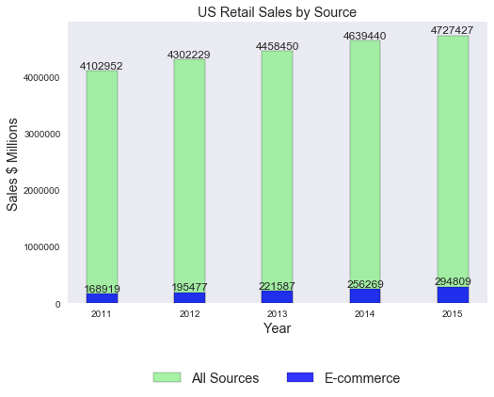
Data Cleanup & Exploration (Figures)
E-commerce hasn’t ‘eaten the world’ yet
E-commerce sales as a percentage of total retail sales in the US are growing, but still a relatively small 6% of total retail sales

Slide 9
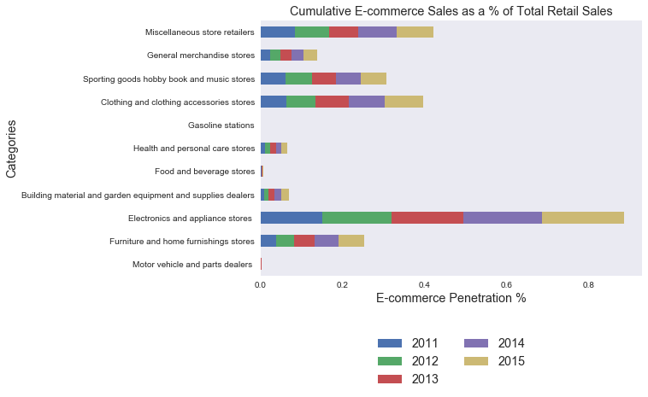
Data Cleanup & Exploration (Figures)
E-commerce penetration is having a cumulative affect in some categories more than others
Penetration highest in:
Electronics and appliances
Clothing
General merchandise

Slide 10
Selected Individual Categories

Slide 11
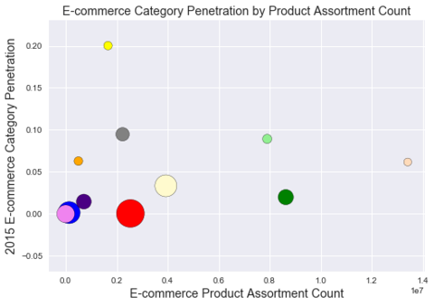
Data Cleanup & Exploration (Figures)
There is a substantial correlation between product assortment offered by E-commerce retailers and penetration of E-commerce sales within those categories
One exception is in electronics where market penetration is the highest despite having below average product assortment available

Slide 12
Data Cleanup & Exploration (Figures)
There are some large retail segments which haven’t been significantly penetrated by E-commerce:
Food and beverage
General merchandise
Health & Personal Care

Slide 13
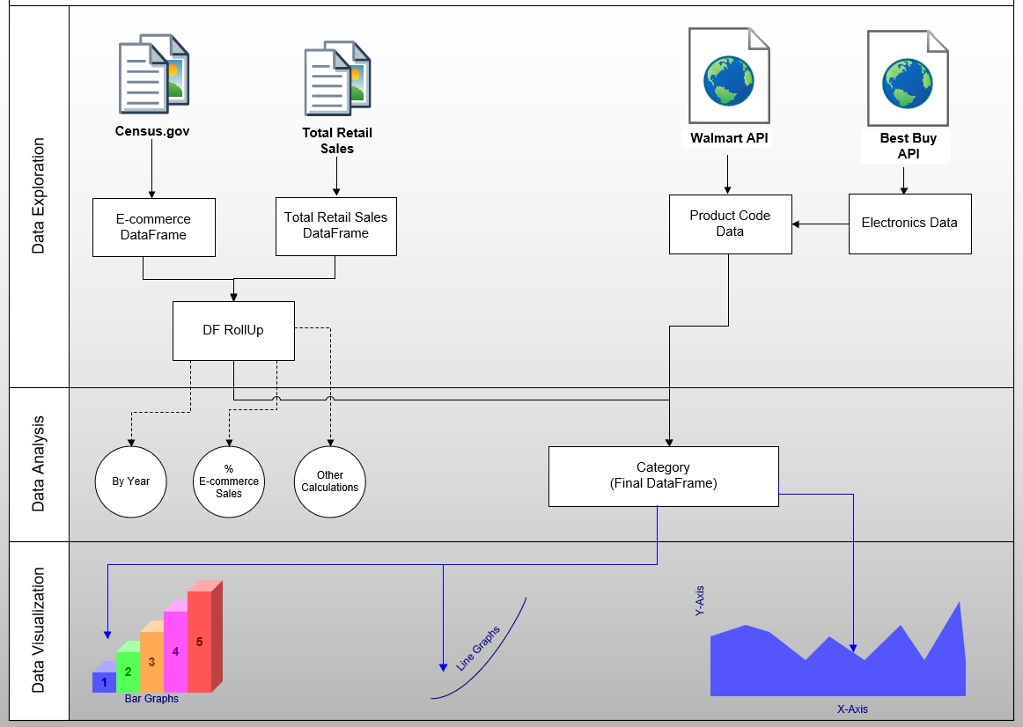
Data Analysis Flow Chart

Slide 14
Discussion
What did we expect to find?
Thought E-commerce penetration would be higher than it actually is
Books, music, and electronics penetration were as expected
Surprised how much furniture and clothing have been penetrated by E-commerce
General Conclusions
E-commerce sales as a percentage of total retail sales is growing, but still a relatively small 6% of total retail sales as of 2015
Certain categories E-commerce sales are growing faster than others, and represent a significantly higher percentage of total retail sales than others

Slide 15
Lessons Learned
Difficulties & How We Dealt With Them
Amazon.com requires you to be a validated retailer before granting access to their API – no students, so we used Walmart.com
Walmart.com API malfunction – dropped 2 of 30 categories for analysis (we were not able to retrieve product counts, so we used BestBuy.com to fill in the gaps)
What Would We Research (if we had more time)
Other sources of E-commerce data other than Walmart.com
Paid datasets (e.g., Nielsen)
Obtain sample product dimensions and weights as other possible correlating factors E-commerce could penetrate (ease of shipping)
Walmart.com had store geolocation API for potential additional analysis of bricks and mortar
Surveys to better understand trends and personal feedback

Slide 16
Thank You!
Kamila Bajaria, Caitlyn Ta, Tashia Hughes, Charles Nguyen

